Slide 1
Northwind Data project
By Aviv Uziel, Data analyst

Slide 2
Our main leading question:
How can Northwind increase its profits using data-driven decisions?

Slide 3


overview

Slide 4
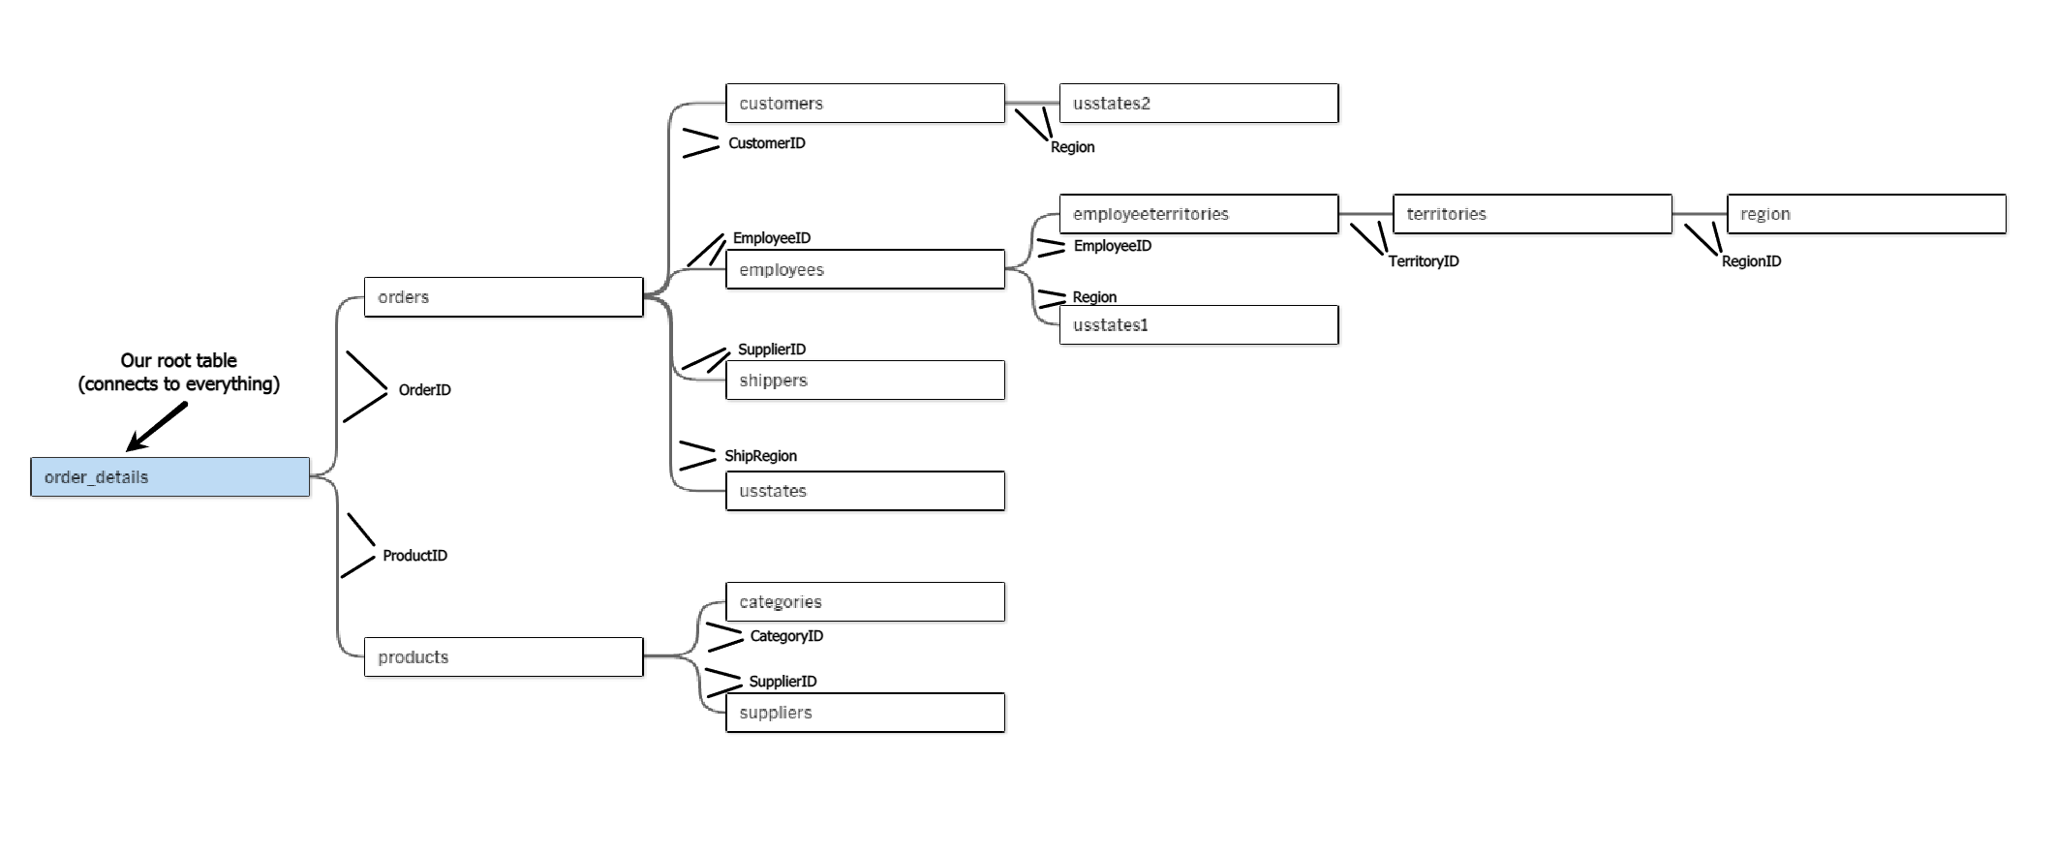
Our database
Northwind’s database is made of a total of 11 tables:

Slide 5




Some general metrics:
Northwind’s Data Range:
JULY/1996
MAY/1998
1.8 years
Total Revenue So Far
$541,109
Leading Countries By Revenue
Avg. Monthly Growth
8.5%
1. USA $105K
2. Germany $101K
3. Austria $53K
4. Brazil $45K
5. France $34K
Profit Margin
42.7%

Slide 6




For this project, we chose 3 main areas of focus:
Deliveries
locations
Product catalogue

Slide 7
Deliveries

Slide 8

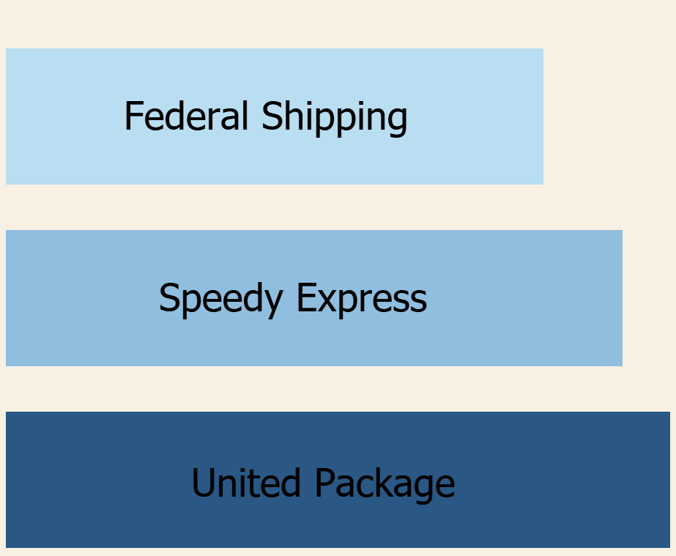

Deliveries (1)
Shipping company
Avg. delivery time
→ ~7.5 DAYS
→ ~8.6 DAYS
→ ~9.2 DAYS
Global average
8.5 DAYS

Slide 9


Deliveries (2)
Finland
Has the best delivery times
5.6 DAYS
On average

Slide 10
Deliveries (3)
Late Deliveries % (Global)
Worst performing cities
Country | City | Late %
Brazil | Campinas | 33.3%
USA | Elgin | 20%
Germany | Leipzig | 20%
Italy | Torino | 16.7%
Ireland | Cork | 15.8%
USA | Seattle | 14.3%
Spain | Madrid | 12.5%
France | Marseille | 11.8%
Sweden | Luleו | 11.1%
USA | Lander | 11.1%

Slide 11
locations

Slide 12


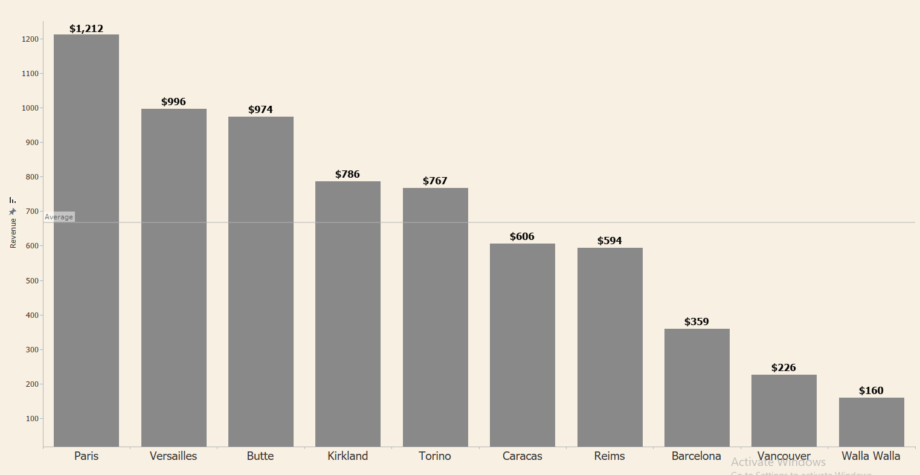
Locations (1)
Low Revenue Cities
Top Country By Market Share
%19.4
* average revenue of $668, compared to a global average of $7.7K

Slide 13
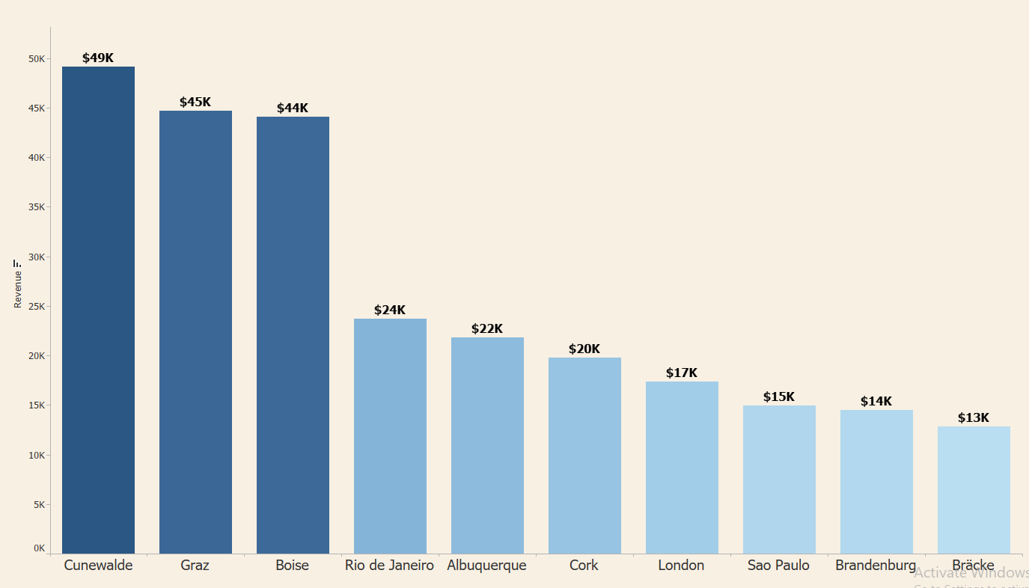
Locations (2)
Leading Cities By Revenue

Slide 14
Product Catalogue

Slide 15

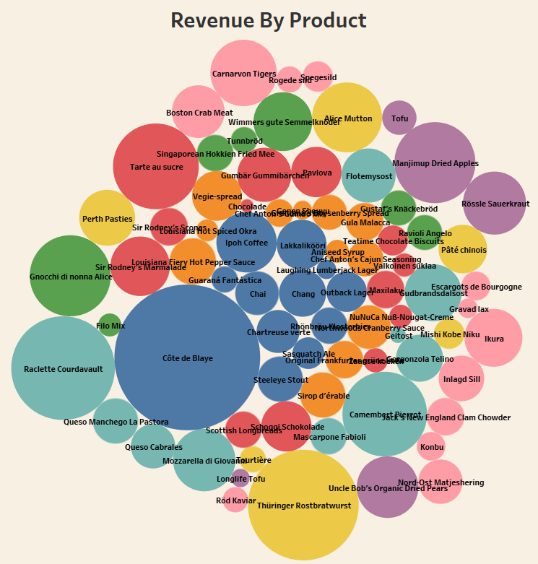
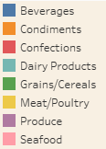
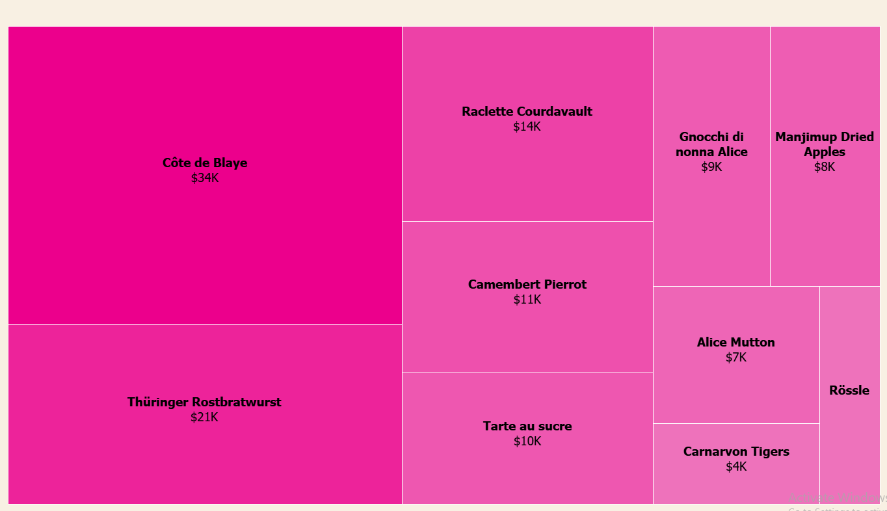

Product catalogue (1)
Top 10 Best Selling Products
Best Selling Product
Côtes de Blaye

Slide 16
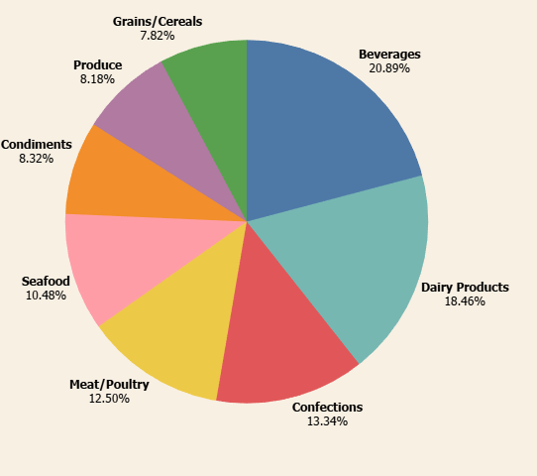


Product catalogue (2)
product categories by revenue share
Our Leading Category
Beverages

Slide 17

Conclusions (1)
Deliveries:
“Federal Shipping” is the best company in terms of delivery time, let’s increase our deliveries with them when possible also try to talk to “United Package” to make their delivey time better.
Focus on the 10 cities in the chart (Deliveries 2) - try to decrease delivery time in those cities. Moreover, we should examine all cities with late deliveries worst than global average of 5% and ensure better delivery.
Locations:
We should focus on the USA, as it’s clearly the biggest source of revenue.
We must grow our market in the low revenue cities, as most of them have big potential.
USA, Germany & Brazil, are some of our biggest revenue sources, their favorite product is “Côtes de Blaye”. We should aim to focus on these cities, and on this particular product + other similar products for them.

Slide 18
Conclusions (2)
Products:
Our most successful categories are Beverages & Dairy Products. we should be focusing on them in our marketing strategy and aim to add more products of these types.
Focus our marketing on our 5 leading products as their demand is very high.

Slide 19
THANK YOU

Slide 20

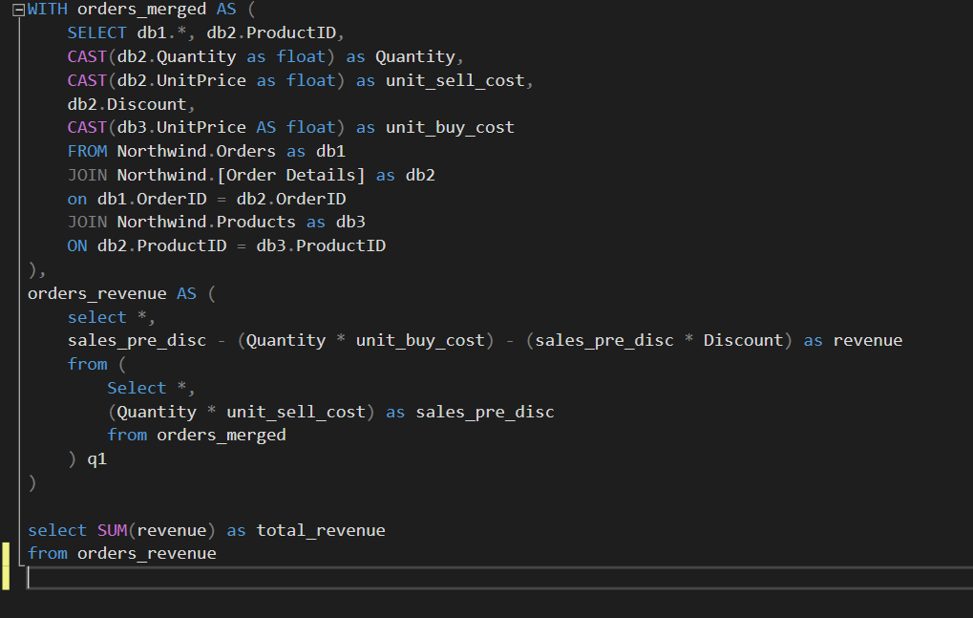
Overview (total revenue)
Appendix (1)

Slide 21
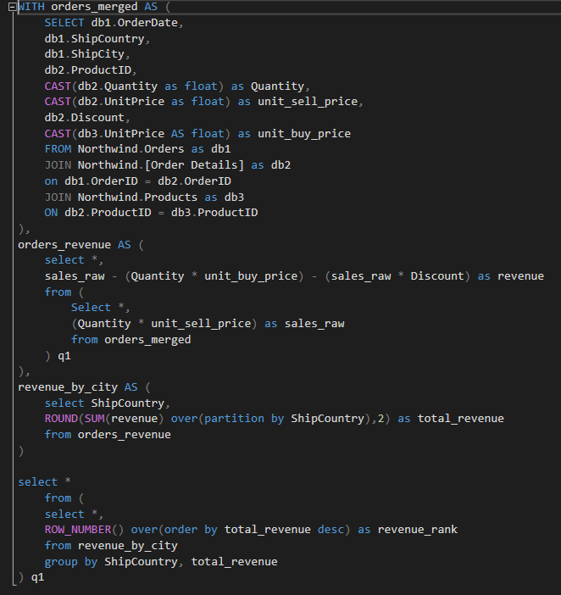
Overview (revenue by country)
Appendix (2)

Slide 22
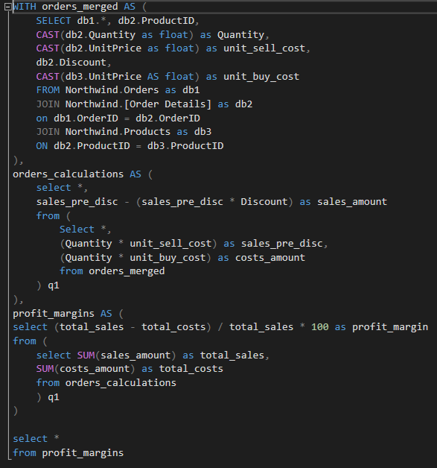
Overview (Profit margin)
Appendix (3)

Slide 23
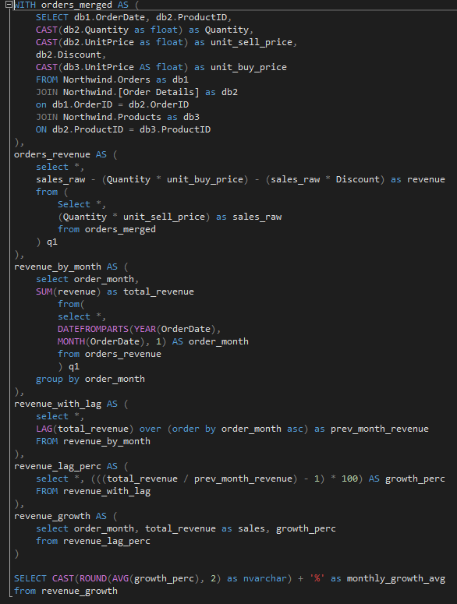
Overview (average monthly growth)
Appendix (4)

Slide 24
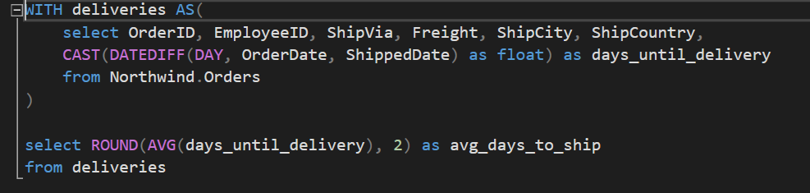
deliveries (average days to ship)
Appendix (5)

Slide 25
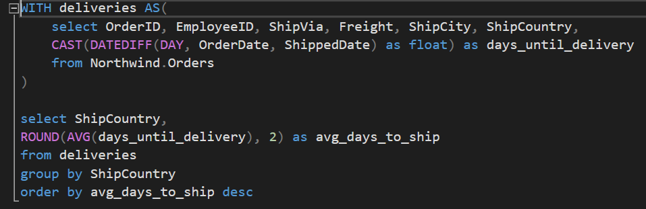
deliveries (average days to ship by country)
Appendix (6)

Slide 26
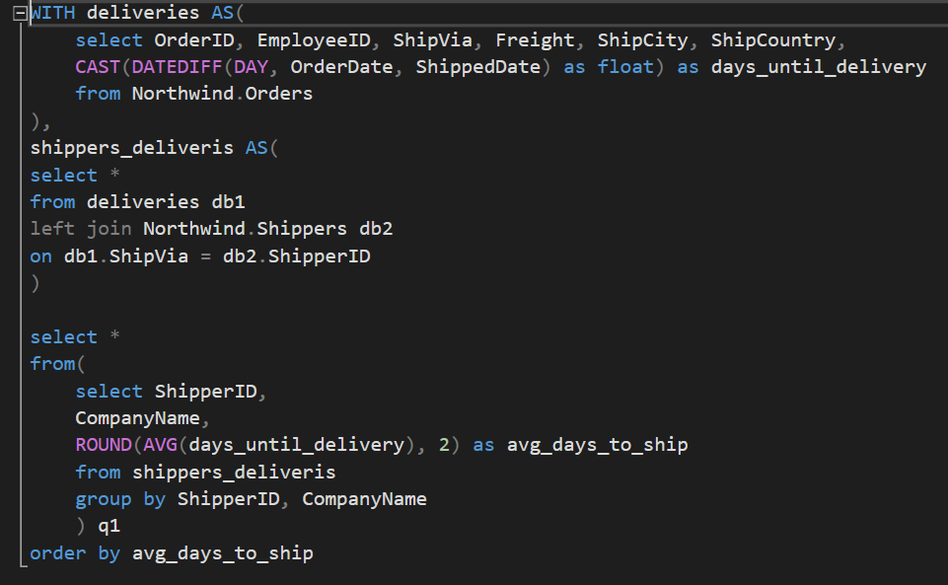
deliveries (average days to ship by Shipper)
Appendix (7)

Slide 27
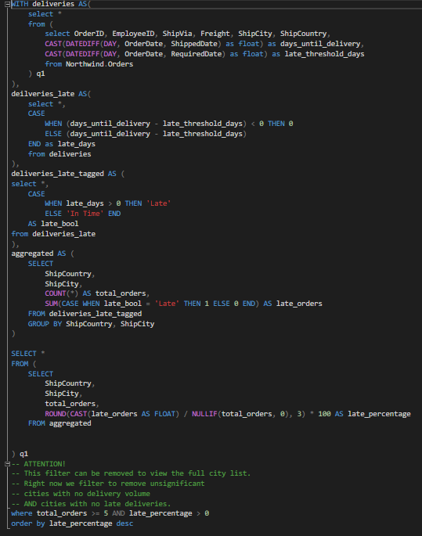
deliveries (Late % by city)
Appendix (8)

Slide 28
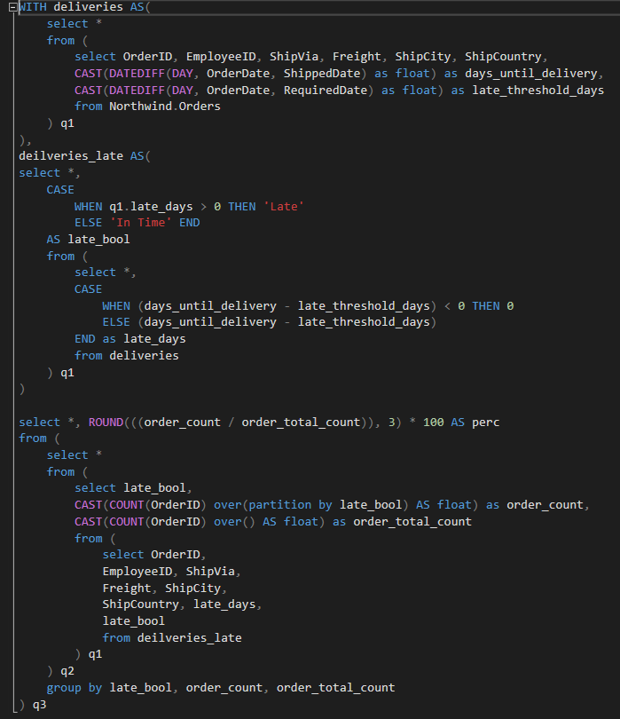
deliveries (Late % overall)
Appendix (9)

Slide 29
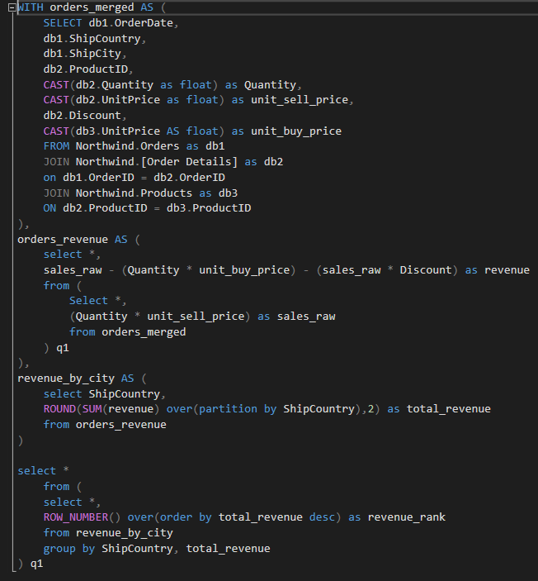
Locations (revenue by city)
Appendix (10)

Slide 30
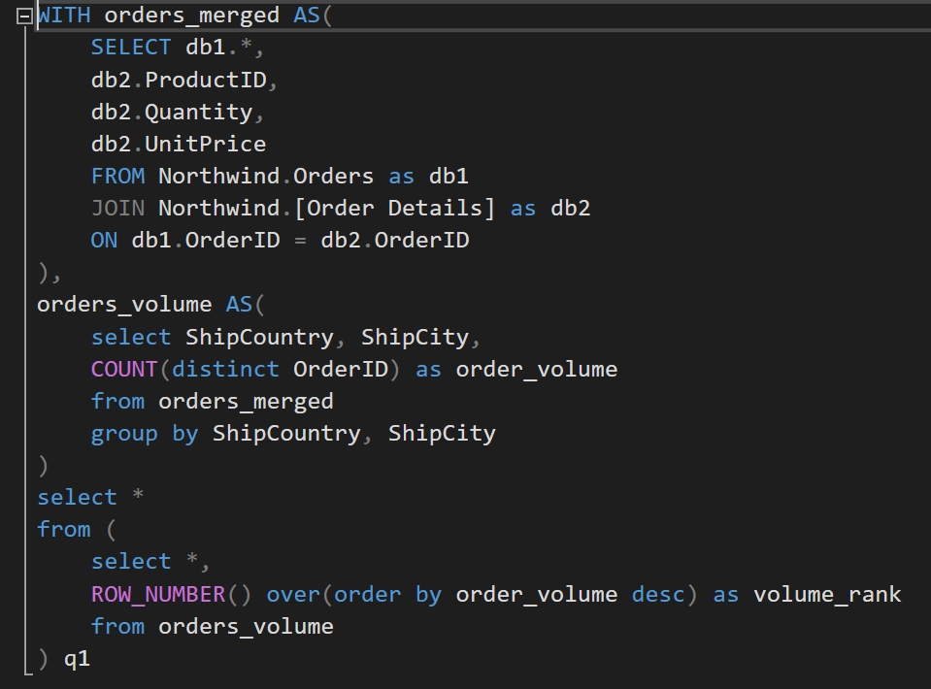
Locations (order count by country)
Appendix (11)

Slide 31
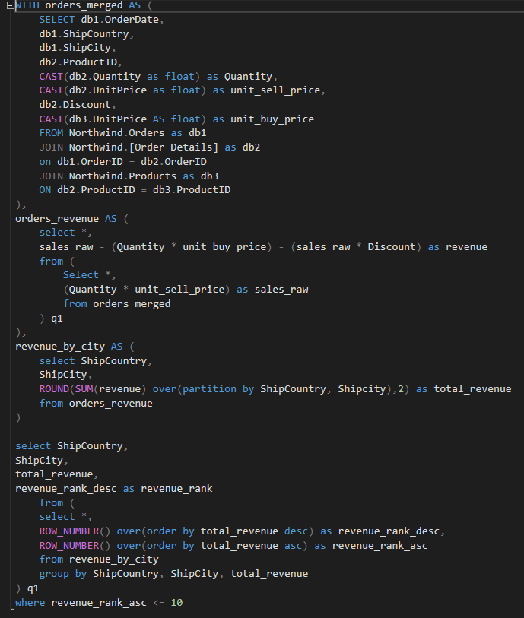
Locations (bottom 10 cities by revenue)
Appendix (12)

Slide 32
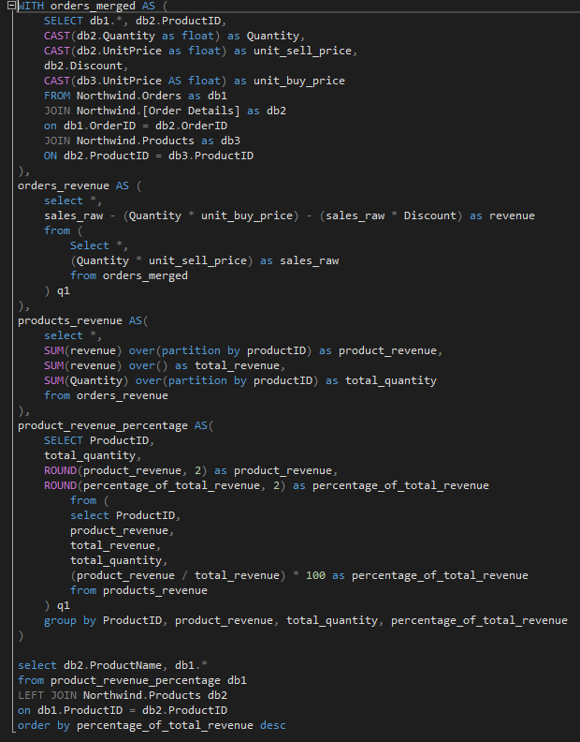
Product catalogue (revenue by product)
Appendix (13)

Slide 33
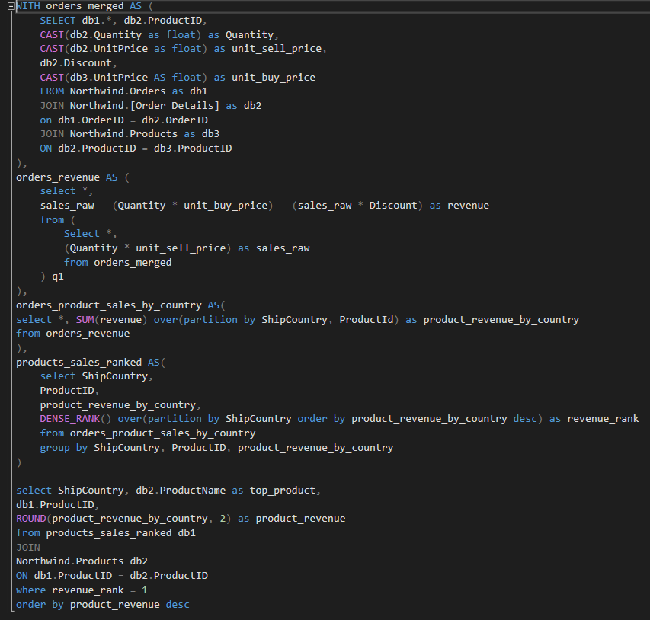
Product catalogue (most sold product by country)
Appendix (14)

